Slide 1
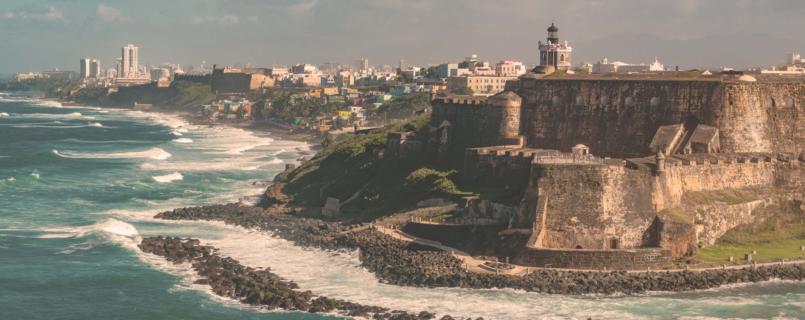




San Juan to Spain Transatlantic
San Juan • Philipsburg • Funchal • Tangier • Barcelona
2 nights in San Juan + 12 nights sailing
Departing 20 April 2028
All flights included
Insider Lock It In rate from
Sea View Lock It In rate from £2103
£1991pp
£60pp in resort fees payable locally. Subject to change. View terms here: sellvv.co.uk/terms
Insert your
logo here

Slide 2
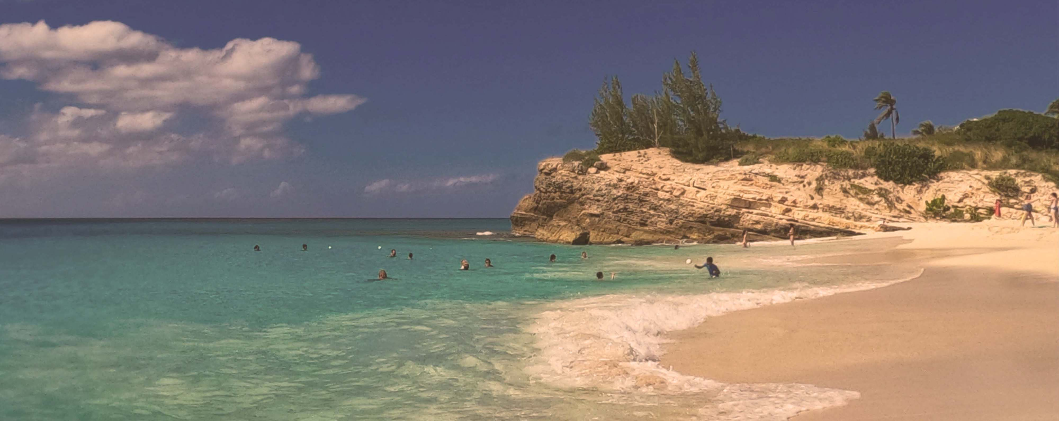
Eastern Caribbean & Bimini Holiday
Miami • San Juan • Charlotte Amalie • Philipsburg • The Beach Club at Bimini • Miami
1 night in Miami + 9 nights sailing
Departing 13 December 2026
All flights included
Insider Lock It In rate from
Sea Terrace Lock It In rate from £1681pp
£1553pp
£60pp in resort fees payable locally. Subject to change. View terms here: sellvv.co.uk/terms
Insert your
logo here

Slide 3

The Adriatic, Albania & Greece
Athens (Piraeus) • Dubrovnik • Kotor • Sarandë • Mykonos • Athens (Piraeus)
1 night in Athens + 7 nights sailing
Departing 14 August 2027
All flights included
Lead in package price from
Sea Terrace cabin from £2399pp
£2099pp
£30pp in resort fees payable locally. Subject to change. View terms here: sellvv.co.uk/terms
Insert your
logo here

Slide 4

French Riviera, Spain & Ibiza Overnight
Barcelona • Cannes • Provence (Toulon) • Valencia • Ibiza • Barcelona
1 night in Barcelona + 7 nights sailing
Departing 10 July 2027
All flights included
Lead in package price from
Sea Terrace cabin from £2149pp
£1849pp
£30pp in resort fees payable locally. Subject to change. View terms here: sellvv.co.uk/terms
Insert your
logo here

Slide 5
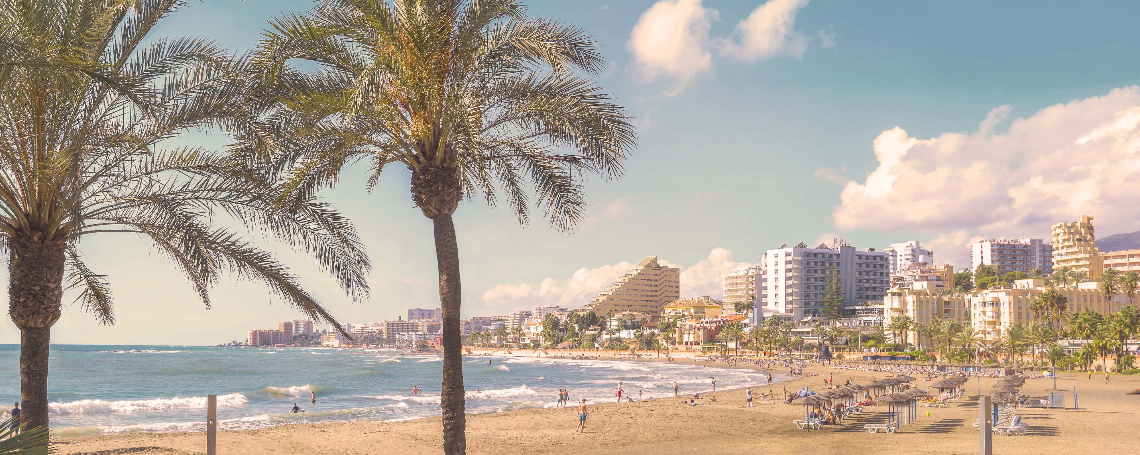
Miami to Morocco & Spain Transatlantic
Miami • Santa Cruz de Tenerife • Tangier • Málaga • Barcelona
1 night in Miami + 14 nights sailing
Departing 1 May 2027
All flights included
Lead in package price from
Sea Terrace cabin from £2549pp
£2099pp
£30pp in resort fees payable locally. Subject to change. View terms here: sellvv.co.uk/terms
Insert your
logo here

Slide 6
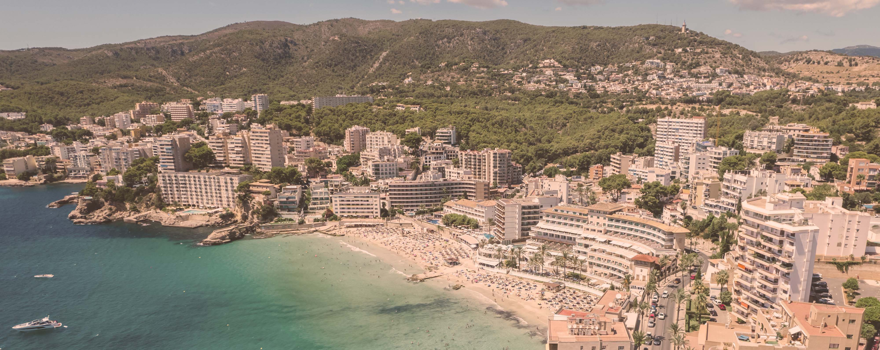
Italy, French Riviera & Spain
Barcelona • Tuscany/Cinque Terre (La Spezia) • Rome (Civitavecchia) • Ajaccio •
Provence (Marseille) • Palma de Mallorca • Barcelona
1 night in Barcelona + 7 nights sailing
Departing 3 July 2027
All flights included
Lead in package price from
Sea Terrace cabin from £2049pp
£1749pp
£30pp in resort fees payable locally. Subject to change. View terms here: sellvv.co.uk/terms
Insert your
logo here

