Slide 1





Solar Eclipse: Spain, Portugal, Morocco
Barcelona • Palma de Mallorca • Málaga • Seville (Cádiz) • Funchal • Tangier • Valencia • Barcelona
1 night in Barcelona + 11 nights sailing
Departing 27 July 2027
All flights included
Lead in package price from
Sea Terrace cabin from £3064pp
Offer reference 132642
£2999pp
£30pp in resort fees payable locally. Subject to change. View terms here: sellvv.co.uk/terms
Insert your
logo here

Slide 2

Miami to Morocco & Spain Transatlantic
Miami • Las Palmas de Gran Canaria • Casablanca • Valencia • Barcelona
1 night in Miami + 14 nights sailing
Departing 23 April 2027
All flights included
Lead in package price from
Sea Terrace cabin from £2149pp
£1899pp
£60pp in resort fees payable locally. Subject to change. View terms here: sellvv.co.uk/terms
Insert your
logo here

Slide 3

Greek Isles & The Adriatic
Athens (Piraeus) • Mykonos • Kotor • Corfu • Dubrovnik •
Santorini • Bodrum • Chania (Souda Bay) • Athens (Piraeus)
1 night in Athens + 11 nights sailing
Departing 29 May 2027
All flights included
Lead in package price from
Sea Terrace cabin from £2849pp
£2499pp
£30pp in resort fees payable locally. Subject to change. View terms here: sellvv.co.uk/terms
Insert your
logo here

Slide 4

Sisters at Sea: Brilliant Lady
Miami • Phillipsburg • Tortola • St Croix • San Juan • Puerto Plata • The Beach Club at Bimini • Miami
1 night in Miami + 10 nights sailing
Departing 7 February 2027
All flights included
Lead in package price from
Sea Terrace cabin from £2819pp
Offer reference 127371
£2349pp
£60pp in resort fees payable locally. Subject to change. View terms here: sellvv.co.uk/terms
Insert your
logo here

Slide 5

Greek Isles & Mykonos Overnight
Athens (Piraeus) • Santorini • Rhodes • Bodrum • Mykonos • Athens (Piraeus)
1 night in Athens + 7 nights sailing
Departing 26 June 2027
All flights included
Lead in package price from
Sea Terrace cabin from £2199pp
£1949pp
£30pp in resort fees payable locally. Subject to change. View terms here: sellvv.co.uk/terms
Insert your
logo here

Slide 6
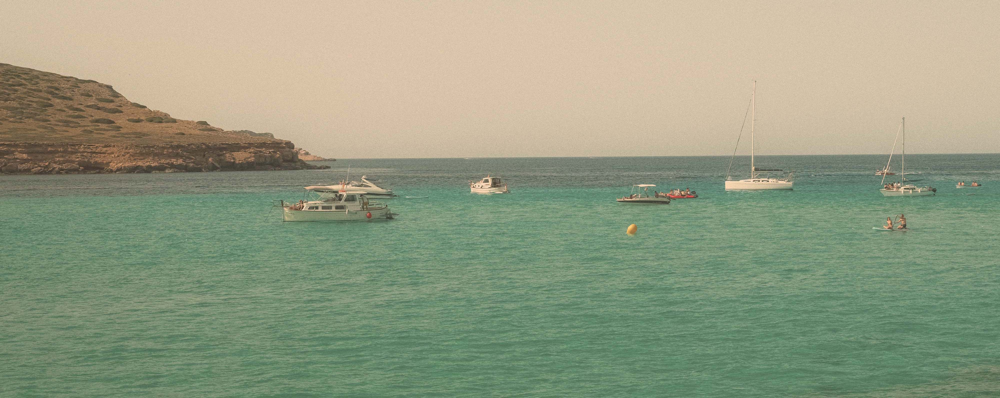
French Riviera, Spain & Ibiza Overnight
Barcelona • Nice (Villefranche) • Provence (Toulon) • Valencia • Ibiza • Barcelona
1 night in Barcelona + 7 nights sailing
Departing 26 June 2027
All flights included
Lead in package price from
Sea Terrace cabin from £1949pp
£1749pp
£30pp in resort fees payable locally. Subject to change. View terms here: sellvv.co.uk/terms
Insert your
logo here

