Slide 1





Eastern Caribbean & Bimini Beach Club
Miami • Philipsburg • Tortola • St. Croix • San Juan • Puerto Plata • The Beach Club at Bimini • Miami
1 night in Miami + 10 nights sailing
Departing 29 November 2026
All flights included
Lead in package price from
Sea Terrace cabin from £1899pp
Offer reference 133024
£1799pp
£60pp in resort fees payable locally. Subject to change. View terms here: sellvv.co.uk/terms
Insert your
logo here

Slide 2

Eastern Caribbean & Bimini Beach Club
Miami • Philipsburg • Tortola • Basseterre • St. John's • The Beach Club at Bimini • Miami
1 night in Miami + 10 nights sailing
Departing 14 November 2026
All flights included
Lead in package price from
Sea Terrace cabin from £2079pp
Offer reference 133107
£1999pp
£60pp in resort fees payable locally. Subject to change. View terms here: sellvv.co.uk/terms
Insert your
logo here

Slide 3
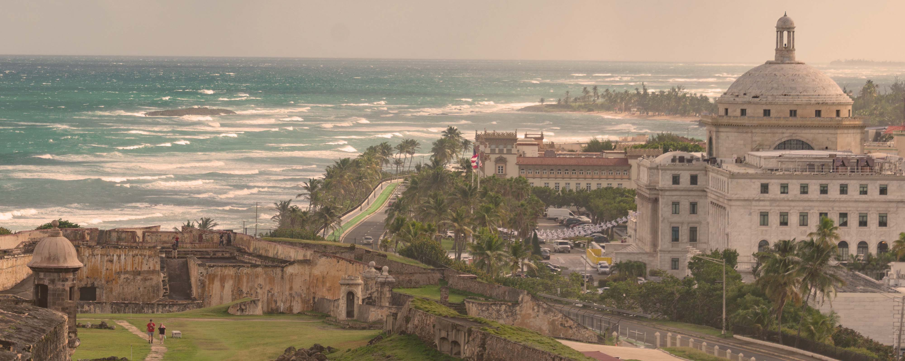
Eastern Caribbean & Bimini Beach Club
Miami • Philipsburg • Tortola • St. Croix • San Juan • Puerto Plata • The Beach Club at Bimini • Miami
1 night in Miami + 10 nights sailing
Departing 10 January 2027
All flights included
Lead in package price from
Sea Terrace cabin from £2059pp
Offer reference 132963
£1899pp
£60pp in resort fees payable locally. Subject to change. View terms here: sellvv.co.uk/terms
Insert your
logo here

Slide 4

Eastern Caribbean & Bimini Beach Club
Miami • Philipsburg • Tortola • Basseterre • St. John's • The Beach Club at Bimini • Miami
1 night in Miami + 10 nights sailing
Departing 24 January 2027
All flights included
Lead in package price from
Sea Terrace cabin from £2299pp
Offer reference 133026
£1999pp
£60pp in resort fees payable locally. Subject to change. View terms here: sellvv.co.uk/terms
Insert your
logo here

Slide 5

Eastern Caribbean & Bimini Beach Club
Miami • Philipsburg • Tortola • Basseterre • St. John's • The Beach Club at Bimini • Miami
1 night in Miami + 10 nights sailing
Departing 21 February 2027
All flights included
Lead in package price from
Sea Terrace cabin from £2299pp
Offer reference 133027
£1899pp
£60pp in resort fees payable locally. Subject to change. View terms here: sellvv.co.uk/terms
Insert your
logo here

Slide 6

Eastern Caribbean & Bimini Beach Club
Miami • Philipsburg • Tortola • St. Croix • San Juan • Puerto Plata • The Beach Club at Bimini • Miami
1 night in Miami + 10 nights sailing
Departing 7 March 2027
All flights included
Lead in package price from
Sea Terrace cabin from £2249pp
Offer reference 133028
£1899pp
£60pp in resort fees payable locally. Subject to change. View terms here: sellvv.co.uk/terms
Insert your
logo here

